Slide 1
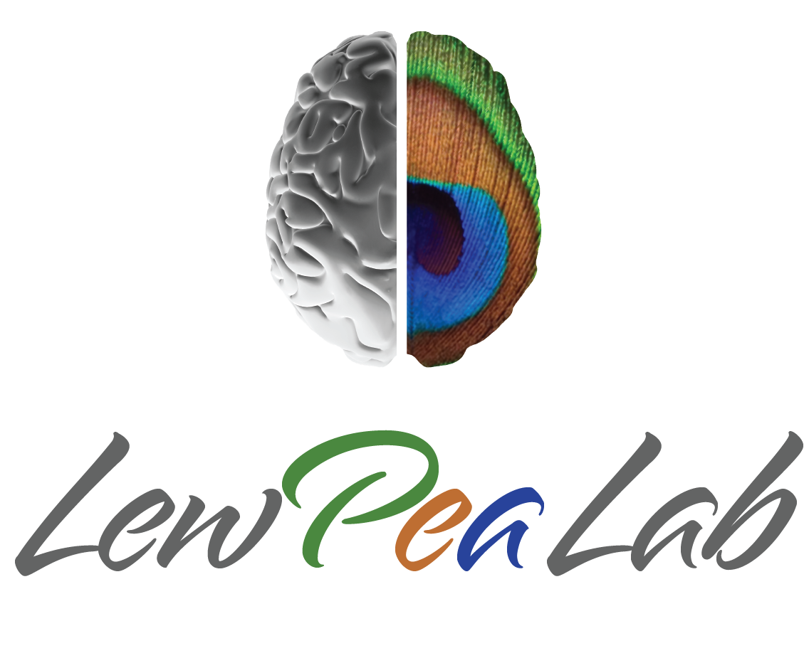
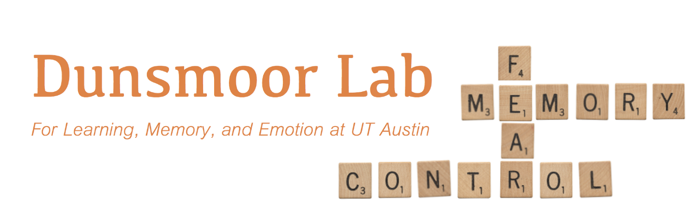
Neural reinstatement reveals divided organization of fear and extinction memories in the human brain
Augustin C. Hennings
Dunsmoor & Lewis-Peacock labs, UT Austin
Austin, TX
Notes:
Hello, my name is Augustin hennings, and I am graduate student at the university of Texas at Austin working with Joey Dunsmoor and Jarrod Lewis-Peacock. Today I am going to be talking about how neural reinstatement reveals the divided organization of fear and extinction in the human brain.

Slide 2
Notes:
Individuals are able to maintain competing representations of threat and safety for closely related stimuli or situations. This is adaptive, as experiences of safety should not necessarily overwrite experiences of threat. In real world situations we are often able to retrieve the association in response to the present context. It is important to understand how the brain organizes these competing memories, as disorganization between them may lead to maladaptive fear and anxiety in harmless situations, as is characteristic in psychiatric disorders such as PTSD. From work in rodents, we know that these memory traces are separated into discrete neural ensembles and pathways between regions of the medial temporal lobe and subdivisions of the medial prefrontal cortex. Within the medial PFC, the prelimbic cortex is involved in the learning and retrieval of fear, while the infralimbic cortex is involved in the learning and retrieval of extinction. While there is some evidence that the same is true in the human homologues of these structures, the dorsal anterior cingulate cortex and ventro-medial prefrontal cortex, robust evidence in the form of encoding specificity has not been observed in humans as it has in rodents.

Slide 3
Experimental design
24hrs
Fear renewal test (data not shown)
+ Recognition memory test
N = 24 Healthy adults
N = 24 Individuals with PTSD symptoms
Notes:
To address this gap between animal neurophysiology and human neuroimaging, we designed a two-day fMRI study which combines elements of both episodic and associative memory. In this design, the conditioned stimuli are semantic categories of images, either animals or tools, and each trial consists of a unique category exemplar that is never repeated during learning.

Slide 4
Quantifying neural reinstatement in humans
Notes:
The next day, participants return and complete a surprise recognition memory test for all of the unique CS exemplars they encoded on the previous day. This hybrid design overcomes an inherent obstacle to the typical conditioning protocol, that is, typically the same CS, such as a colored shape, is repeated across all phases of the experiment. This means that it is only possible to measure retrieval of either fear or extinction memory at test, but not both. In our hybrid design, we are able to simultaneously isolate specific episodes associated with fear and extinction. We can then quantify the overlap in patterns of activity for each CS as a function of the temporal context in which it was encoded. In this way we are able to directly quantify how these competing memories are distinctly organized into sparable patterns of activity in a within-subjects design, and in a single experiment. This approach is thus analogous to activity-dependent labeling work as in rodents.

Slide 5
No behavioral differences between groups

Slide 6
Healthy adults exhibit double dissociation of emotional memories across the mPFC
Healthy
PTSS
Notes:
The data I’m showing here is encoding-retrieval similarity in our two medial PFC regions of interest. The voxel-wise patterns of activity elicited by each CS item during the recognition memory test was correlated with the pattern of activity elicited by the same CS when it was initially encoded during either fear conditioning or extinction. To control for item-level reinstatement effects, the average CS- correlation was subtracted from the average CS+ correlation. Healthy adults exhibited a significant double dissociation of emotional memory reinstatement across the medial PFC. That is, the dACC exhibited greater reinstatement for CS+ items that were encoded during fear conditioning, and this was stronger than fear reinstatement observed in the vmPFC. Conversely, only the vmPFC exhibited greater CS+ reinstatement for items encoded during extinction learning, and this was reliably stronger than extinction reinstatement in the dACC. These results thus confirm that these regions of the PFC are engaged in the encoding and retrieval of opposing associative memories. Individuals with PTSD symptoms displayed the same pattern of fear reinstatement as healthy adults. However, this group displayed significant extinction memory reinstatement in the dACC and the not vmPFC, suggesting that extinction memories were misallocated to a region that normally codes for fear.

Slide 7
Fear and extinction are organized along the long-axis of the hippocampus
Posterior HC
Anterior HC
Healthy
PTSS
Notes:
In addition to the PFC, the hippocampus is another core component of the neurocircuitry involved in the acquisition and retrieval of emotional associative memories. As such, we also probed neural reinstatement along the long axis of the hippocampus. Although we did not find any CS+ specific reinstatement in the regions, a mixed-effects model revealed a significant interaction with encoding context. This suggested that subfields of the hippocampus may be sensitive to encoding context in general, but not CS type. As such, we probed reinstatement by encoding context, collapsed across CS+ and minus. In both groups, the posterior hippocampus exhibited more reinstatement for items encoding during fear conditioning compared to the anterior hippocampus. In healthy adults only, the converse was true, that is the anterior hippocampus exhibited more extinction memory reinstatement compared to the posterior subdivision. This was not observed in our PTSS group, again suggesting that the neural organization of safety memories is dysregulated in PTSD.

Slide 8
MTL reinstatement predicts locus of reinstatement in the mPFC
Notes:
Our analyses in the mPFC showed that healthy adults exhibited a double dissociation of emotional memory reinstatement – we next asked what determines in which area of the mPFC a particular item is reinstated? On a trial-by-trial basis, we assessed whether neural reinstatement in the subfields of the hippocampus and amygdala predicted the location of reinstatement between our two mPFC regions. We found that reinstatement in the central nucleus of the amygdala and the posterior hippocampus both predicted a bias in reinstatement towards the dACC, while reinstatement in the anterior hippocampus predicted a bias in reinstatement towards the vmPFC. These results confirm that interactions between the medial temporal lobe and the prefrontal cortex balance the behavioral expression of emotional memories in the human brain.

Slide 9
Stay tuned! The full paper is currently in press at Current Biology
Thanks to my co-authors:
Mason McClay
Dr. Michael Drew
Dr. Jarrod Lewis-Peacock
Dr. Joseph Dunsmoor
NIH funding:
F31MH124360
R01EY028746
R01MH122387
R00MH106719
Notes:
If you are interested in this project and would like to learn more, please feel to contact me. In addition, our manuscript is currently in press at currently biology and will published soon. Thank you for your time.

